Slide 1
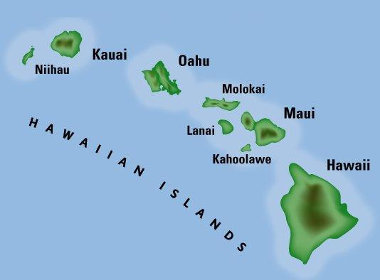
IN THE BEGINNING…
Formation of the Hawaiian Islands to Hawaii Today

Slide 2
Essential Questions:
Where did Hawaii come from?
What makes Hawaii unique?
Why might a visitor come to Hawaii?
In what way does historical knowledge have an impact on what we do today?

Slide 3
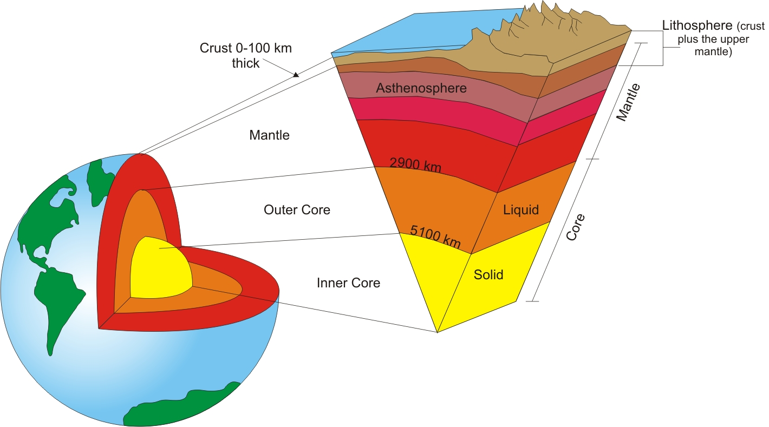
Structure of the Earth, Convection Currents and Tectonic Plates

Slide 4
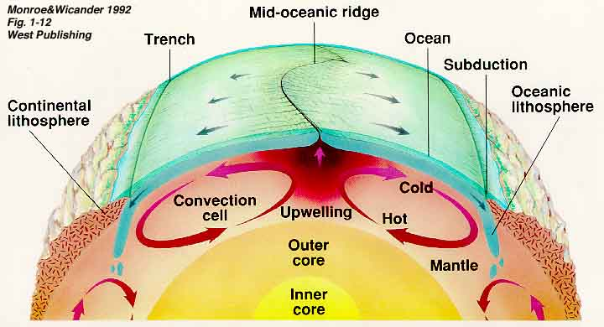
Structure of the Earth, Convection Currents and Tectonic Plates

Slide 5
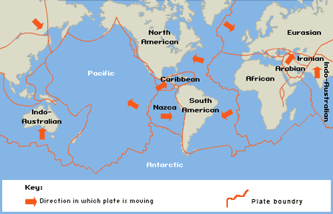
Structure of the Earth, Convection Currents and Tectonic Plates

Slide 6
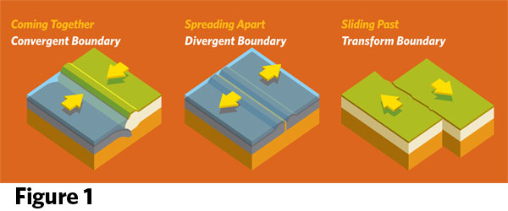
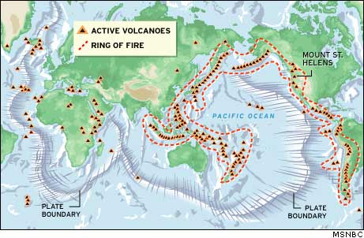
Movements of Plates and the Ring of Fire

Slide 7
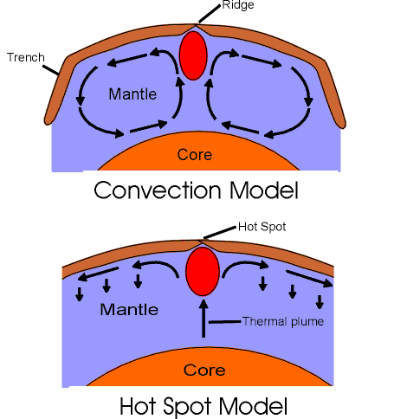
But Hawaii is in the MIDDLE of the Pacific Plate…

Slide 8
X marks the Hot Spot

Slide 9
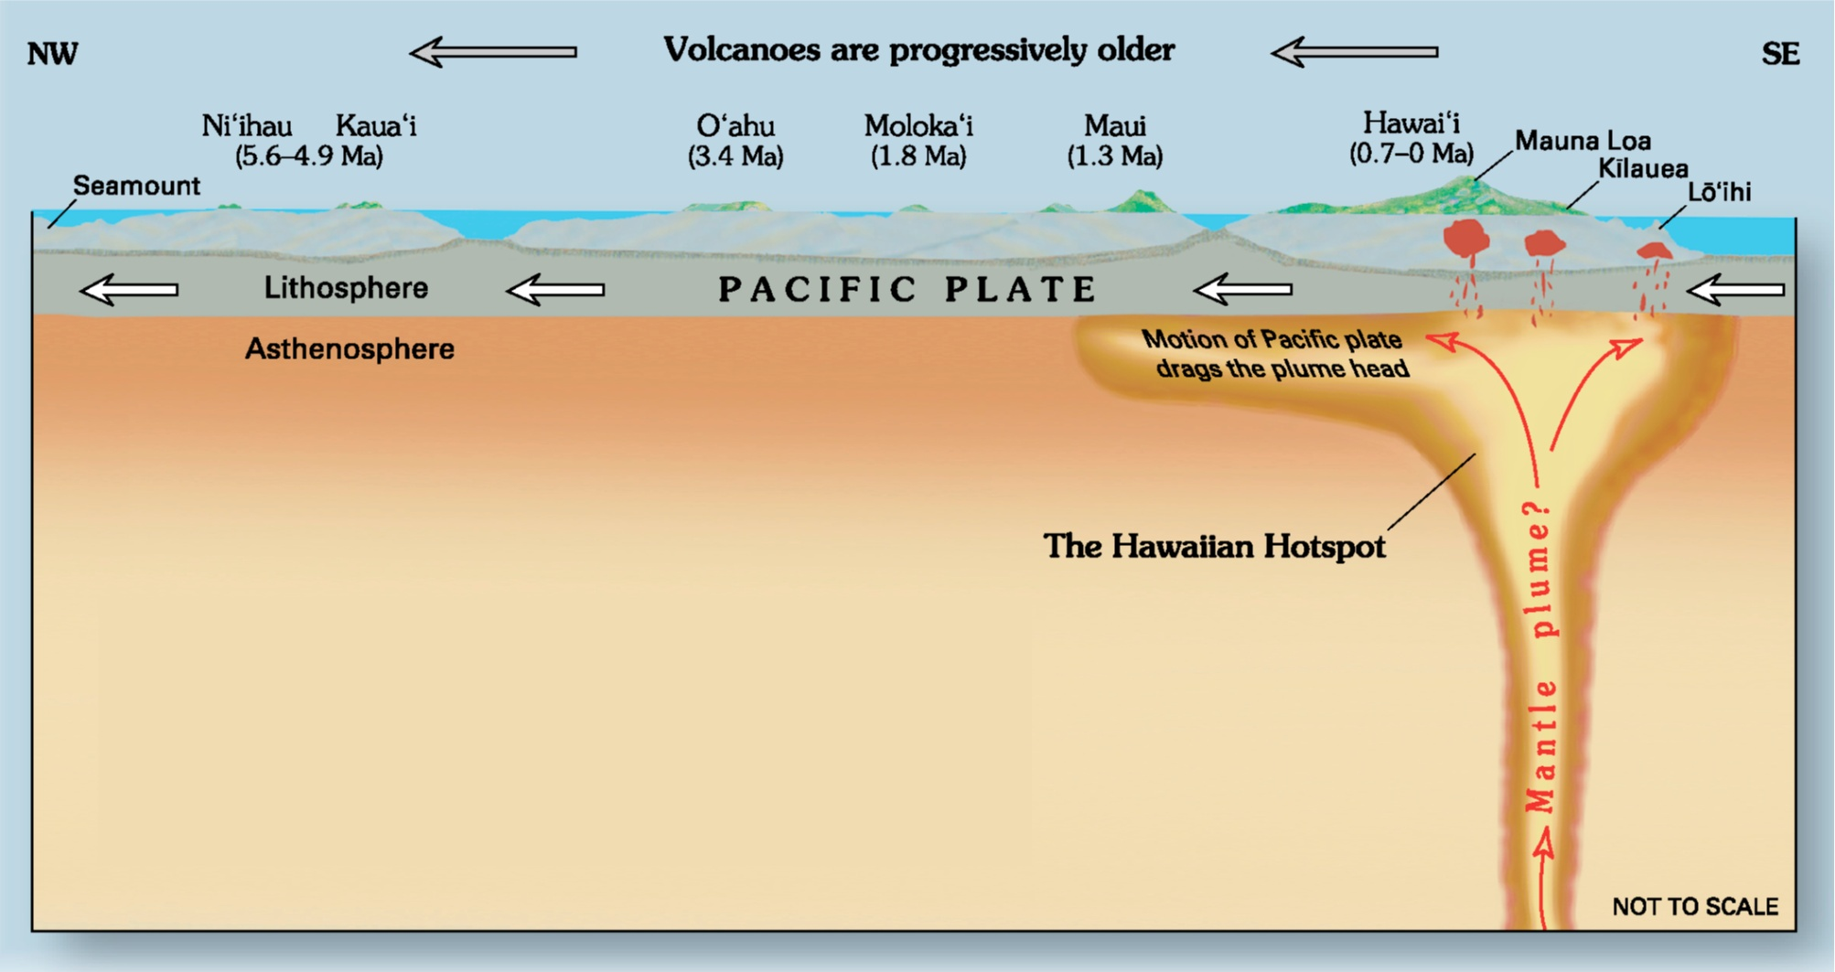

Slide 10
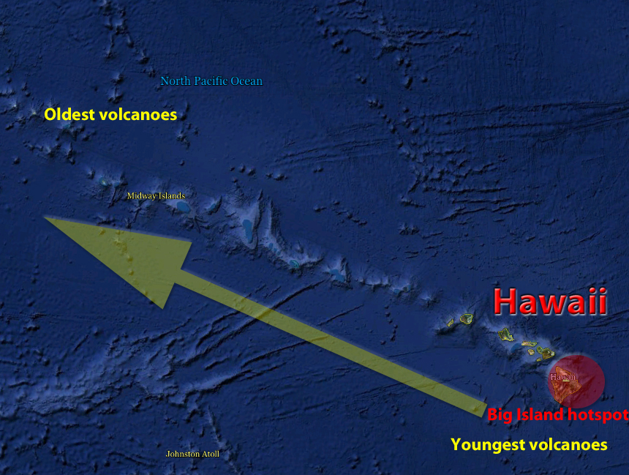

Slide 11
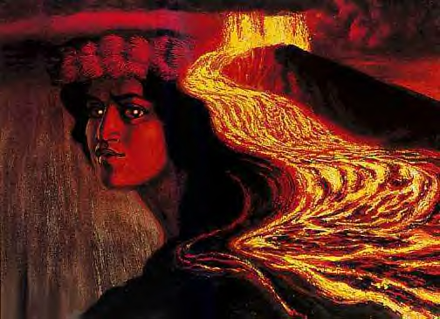
The Legend Of Pele

Slide 12
One day, Hawaii will be nothing more than a memory… Let’s cherish what we have today!

Slide 13
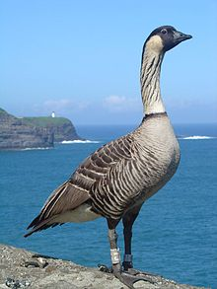
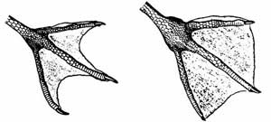
So where did all these plants and animals come from?
3 W’s
  Wind
  Wings
  Waves
Due to extreme isolation and diverse habitats, over millennia, plants and animals evolved to become unique species found no where else in the world (endemic)!
  Hawaii:
    Over 9,000 endemic species
    Over 9,000 indigenous (3 w’s)
Humans

Slide 14
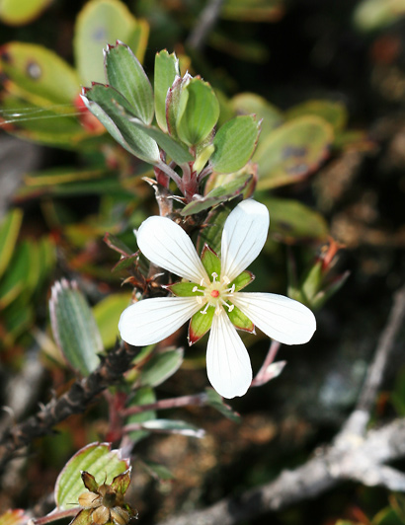
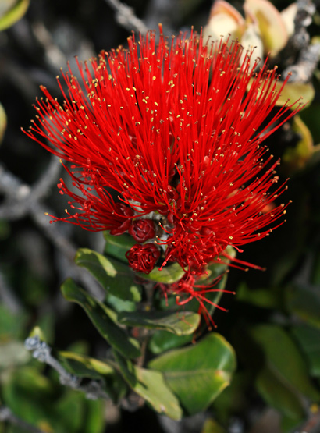
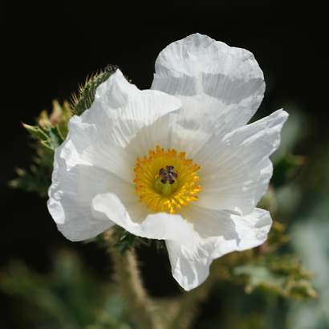
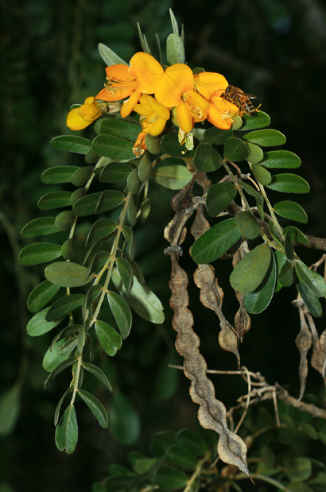
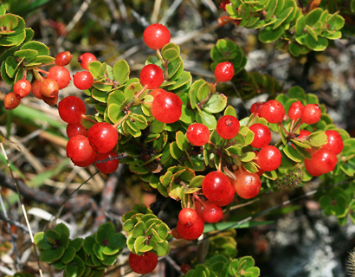
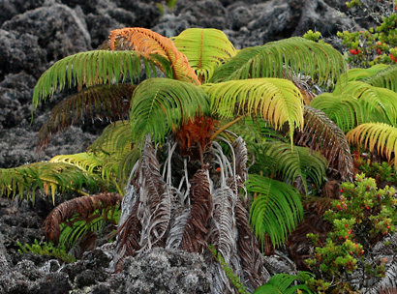
Endemic Flora
Hinahina
Pua Kala
Ohia Lehua
Amaumau Fern
Mamane
Ohelo ‘Ai

Slide 15
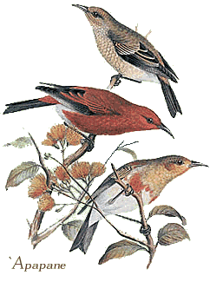
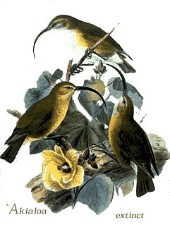
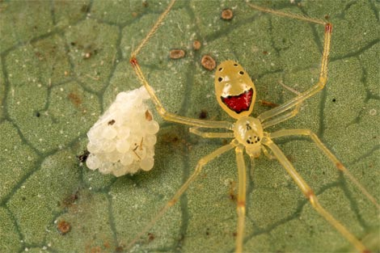
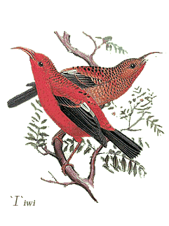
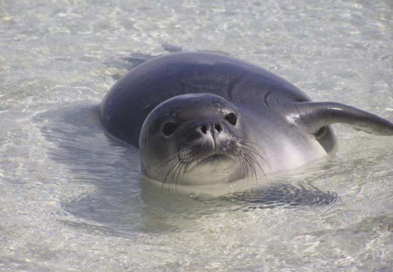
Endemic Fauna

Slide 16
Reflection
Based on the information you just learned, what kind of visitors might be drawn to visit Hawaii?

Slide 17
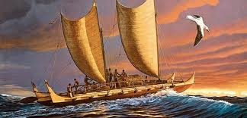
OK, that’s cool, but where did all the people come from?

Slide 18
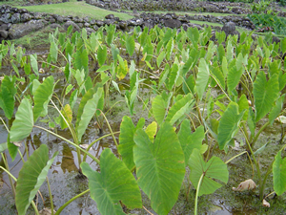
The First Hawaiians
Marquesans – 500 AD
Tahitians – 1000 AD
  Travelled in double hulled canoes
  Pigs, dogs, fowl
  24 canoe plants
    Taro (Kalo)
    Ti
    Gourd (Ipu)
    Candlenut (Kukui)
    Breadfruit (‘ulu)

Slide 19
A New “World” Order
  1200AD Pa’ao , initiated new social order
  Mo’i (king/queen)
  Ali’i (royalty)
  Kahuna (priest and experts in certain professions)
  Maka’ainana (commoner, akin to peasants, usually farmers, craftsmen and fishermen)
  Kaua (slave, outcast, prisoner of war, sacrifice)
Feudal system governed through kapu (taboo), dictated all aspects of life, upon pain of death

Slide 20
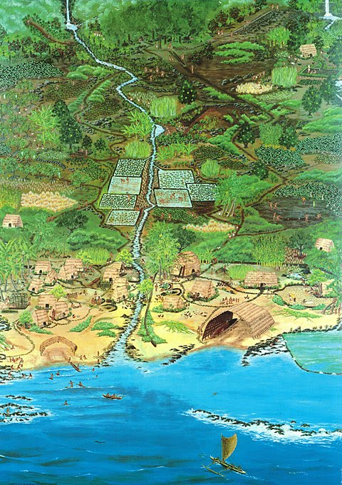
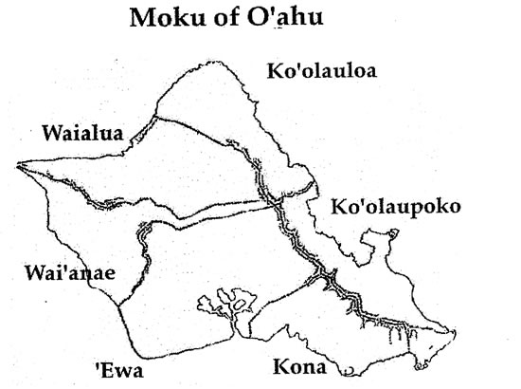
From the mountains to the oceans, from the windward to the leeward side

Slide 21
Let’s FF through MHH
1778 – Captain James Cook is the first known Westerners to reach Hawaiian Islands
  Cook names the islands the Sandwich Isles, in honor of one of his patrons, John Montague, the Earl of Sandwich
1795-1810 Kamehameha unites islands under one rule, becomes King
1800’s
  Hawaii exploited for its sandalwood, whaling, land and people
  Immigrant labor brought in from all over – China, Japan, Portugal, Norway, Germany – changes racial landscape in Hawaii

Slide 22
Let’s FF through MHH
Great Mahele – does away with stewardship of land (ahupua’a system), gives way to land ownership
  Allows westerners to own land, making way for agricultural economy (also government owned land)
  Sugar, pineapples, rice, cotton, cattle
Overthrow of the Hawaiian Monarchy and Annexation by United States of America
August 21, 1959 – Hawaii becomes a state

Slide 23

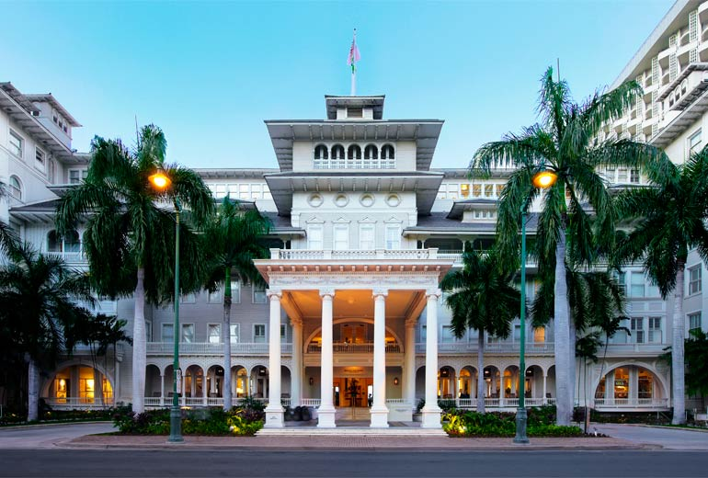
During this time…
People are curious about Hawaii…although only the rich can afford to come here for pleasure
  Mark Twain (Huckleberry Finn, Tom Sawyer)
  Robert Louis Stevenson (Treasure Island)
People could only come by sea (boat)
Following the annexation…
  First hotels – Hawaiian Hotel
    First successful hotel – Moana Surfrider
  Beach Boys and Duke Kahanamoku
  Matson – luxury liners (cruise ships)
  1929 – first inter-island flights
  1935 – first trans-Pacific flights (Pan-American Airlines)

Slide 24
Tourism in Hawaii
From 1959, tourism has been Hawaii’s largest industry, accounting for ~25% of GSP (economic output)
In August 2014 alone - ~730,000 visitors, $1.3 billion in spending (Hawaii Tourism Authority)
Largest generator of jobs (168,000)
In addition to traditional tourism careers/jobs –
  Analyst
  Market Researcher
  Economist

Slide 25
Reflection
What makes Hawaii unique?
Does historical knowledge have an impact on what we do today? Defend your answer.

