Slide 1
Quality Service
Public and Human Services
J. Sugahara

Slide 2
Why? QCS?
Key to establishing and maintaining a successful business
Depends on people because people talk = word-of-mouth publicity (think Yelp!), make recommendations
Can be good or bad
  Bad – 90% or more will not return = 100, 90 will not return, each will tell 9 people = 810 people who will never try your business
  Good - $150, tell two friends, tell two more = $600,000 over 10 years

Slide 3

What is Quality Service (Q.S.)?
Hard to quantify because c.s. is intangible
  You can’t “touch” it rather “feel” it
William B. Martin: Providing Quality Service “Quality customer service is the ability to consistently meet external and internal customer needs, wants and expectations involving procedural and personal encounters.”
Not just one thing - many components add up to q.s.

Slide 4
What is Q.S.?
Who are you servicing?
External vs. Internal Customer
  External – people outside the organization, who choose to do business with you
  Internal – people inside the organization who are helped or otherwise impacted by the work of others within the organization

Slide 5
Two dimensions of Q.S.?
Procedural
Personal
Systems and processes used to deliver products and services
  Organization
  Timeliness
  Anticipation
  Communication
  Policies and Procedures
  Feedback
How service providers use attitudes, behaviors and verbal skills during service encounters
  Customer Needs
  Attitude – nonverbal lang.
  Tact – verbal, written lang
  Problem Solving

Slide 6
The Procedural Side

Slide 7
Organization
Determines who does what, who is in charge of what and how each group works together to move co. forward
No organization = chaos
Different types
  Hierarchical – top – down
  Division
  Functional
  Matrix - Etc.

Slide 8
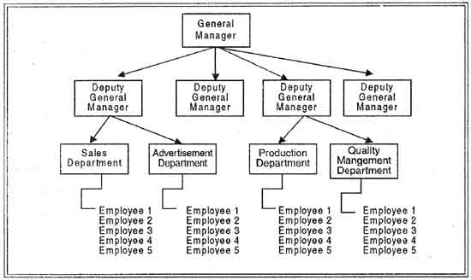

Slide 9
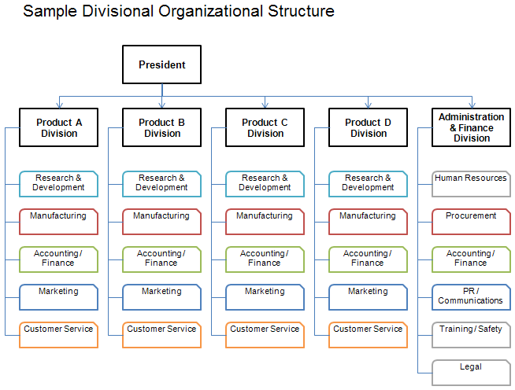

Slide 10
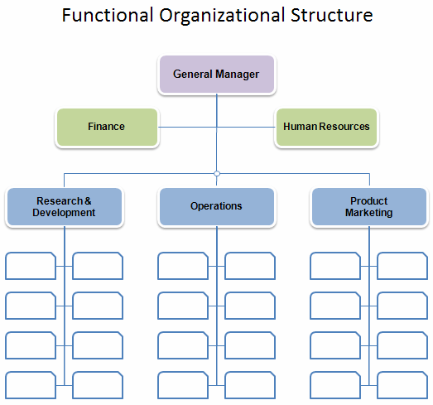

Slide 11
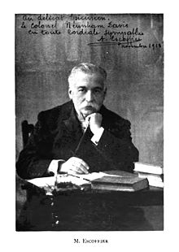
Organization
Brigade de Cuisine - Kitchen Brigade - Georges Auguste Escoffier
Delegates responsibilities to different individuals with specialties

Slide 12
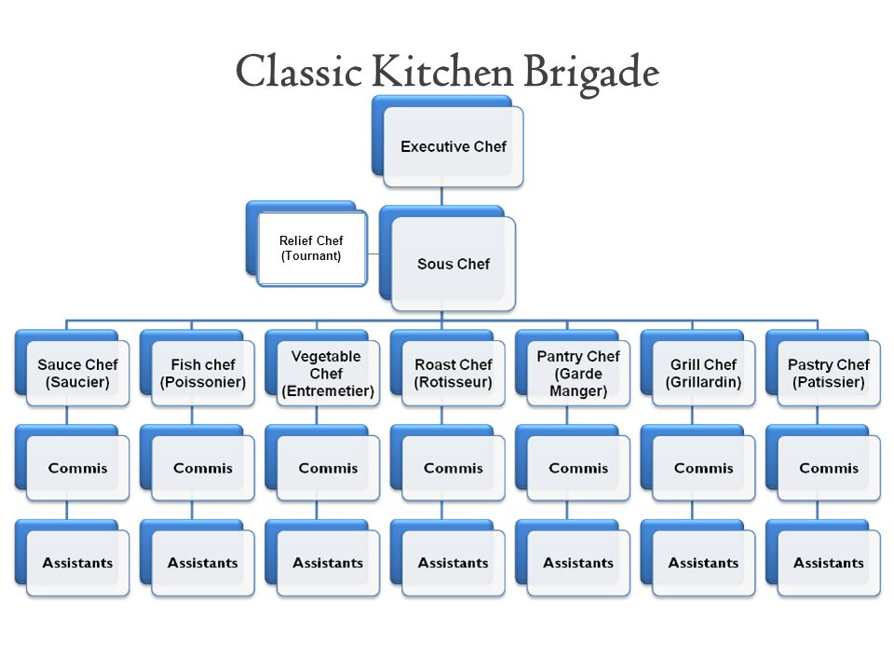

Slide 13
You should be taking Cornell Notes!

Slide 14

Timeliness
Relative to situation and customer’s expectations
  Fast food/checkout at supermarket vs. fine dining/concert
Four components:
  Greeting
  Preservice waits (reservation vs. none, accuracy of quoted time)
  Timing During Service (nature of service, number of steps involved, capacity flow)
  Postservice time (paying for bill)

Slide 15
Anticipation
One step ahead of customers’ needs
Sensitivity to indicators such as:
  group size
  customer age
    children
  how customers are dressed
  what customers have said
  Body language, tone of voice

Slide 16
Your turn! Imagine you work at a restaurant. What might a customer need or want in each situation?
Large group
Children
Teens
Young Adults
Middle Aged Couple
Business Traveler
Seniors
Handicapped Guests
Guest orders messy item
Guests has trouble understanding English
Guest indicates she is in a hurry
Guest is dressed in formal attire
The Rush Period
Empty Beverage Glasses

Slide 17
Activity reflection
Briefly reflect on what happened
Why do you supposed the message was unable to get from the first person to the last?
What could you do to resolve this communication breakdown?

Slide 18
Communication
Cannot anticipate guests’ needs unless communication flows well within/between various parts of the operation
Effective communication = message timely, precise and thorough
Breakdowns happen!
  misunderstandings -> mistakes -> poor customer service

Slide 19
Communication
Avoid = successful communication = understanding = helps systems and procedures = help contribute to high quality customer service
Complete communication
  The sender
  The message
  The receiver
  Feedback

Slide 20

Rap Reiplinger
Room Service Operator

Slide 21
Communication Breakdown
Sender breakdown
  Poor timing
  Wrong method of communication
  Wrong place
  Inappropriate tone of voice
  Poor choice of words or use of wrong words (ninjin vs. ningen)
  Behavioral signals that differ from the verbal message

Slide 22
Communication Breakdown
Message Breakdown
  Too long
  Too short, leaving out info crucial to receiver’s understanding
  Too general or ambiguous
  Communicated too quickly = incomplete reception
  Erroneous or incorrect
  Not transmitted

Slide 23
Communication Breakdown
Receiver breakdown
  Be busy, occupied or otherwise distracted
  Fail to understand the words of the message
  Have an emotional block toward the sender (fear, anger, dislike) – hear what you want/not want to hear
  Believe he/she understands what the message will be so fails to pay proper attention
  Be tired
  Be confused

Slide 24
Communication Breakdown
Feedback breakdown
  Communication sent with no opportunity for sender to find out whether the message was received
  Sender assumes message has been received
  Sender fails to seek, demand or otherwise encourage message feedback
  Receiver fails to provide feedback to the sender, sought or not

Slide 25
Effective Communication
E.C. happens when the message is received exactly as it was intended
Effective communication examples:
  Reservations
  Receive meal as ordered/asked to be prepared
  Understanding and empathetic ear when there is a problem
  Person providing service speak clearly and intelligibly
  Food servers to repeat food/bev orders
  Name used and pronounced correctly

Slide 26
Skit Activity
Performance TASK:
  In pairs, without revealing your selected breakdown, create a skit to demonstrate a communication breakdown
Audience TASK:
  Individually, make three columns on a sheet of paper: Names/breakdown/solution
  Determine the communication breakdown
  For homework, conceive a possible solution to the breakdown DUE 9/8.

Slide 27
You should be taking Cornell Notes!

Slide 28

Policies and Procedures
Policies – general guidelines for what you do – i.e. students will be ready to learn for each class period
Procedures – exactly how to do so – i.e. students will enter the classroom in an orderly manner, and be seated prior to the tardy bell. They will then read the daily agenda and prepare for the upcoming lesson by taking out a pen/pencil and paper. They will do this with little to no disruption.
Helps with decision making as it makes clear what you can and cannot do
Fewer misunderstandings/debates about what to do in certain situations

Slide 29
Think
Without speaking:
  Think of a policy that you know of at school, home or work
  Now, think of the procedures you or a worker may need to follow in order to uphold this policy
  For example:
    Cell phones in school
    Homework collection in English or math
    Dirty Laundry
    Going out with friends
    Greeting customers
    Handling customer complaints
Write down your thoughts if you need to

Slide 30
Think
Analyze whether or not you think this policy has adequate (clear) procedures
If not, determine how the procedures can be improved upon

Slide 31
Pair
You will now need to get up an MOVE.
Without SPEAKING, find a partner in class whose name begins with the same first letter of your first name OR first letter of your last name (yes, it is a CHALLENGE!)

Slide 32

Pair
Share with your partner the policy and corresponding procedures you or a worker may have to follow in order to uphold the policy
Also share with him/her whether or not the procedures were clear/adequate
And finally share what improvements you would make to the procedures if they were not adequate/clear

Slide 33
Share
Select ONE policy and procedure to share with the class and any improvements you made

Slide 34
Policy and Procedures Group Activity
With the people on your table come up with a policy concerning classroom behaviors and the procedures to uphold the policy
  Entering the classroom
  Turning in homework
  Cell phone usage
  When you are absent
  Showing up to class on time
  Leaving the classroom
  Other

Slide 35
You should be taking Cornell Notes!

Slide 36
Feedback
Helps you find out what customers think/feel about their experience you have provided
Without feedback, problems are unnoticed or unresolved
Must be encouraged – for every one received, 26 others fail to register it

Slide 37
Feedback
Specific – how is your steak? Is it cooked to order? Vs. How is everything?
Person-to-person
Multiple approaches
  Written response
    Suggestion boxes
  Surveys
  Focus groups

Slide 38

The Personal Side

Slide 39
The Personal Side
Quality Service depends on the interactions that take place between customers and staff
Attitudes, emotions, feelings

Slide 40
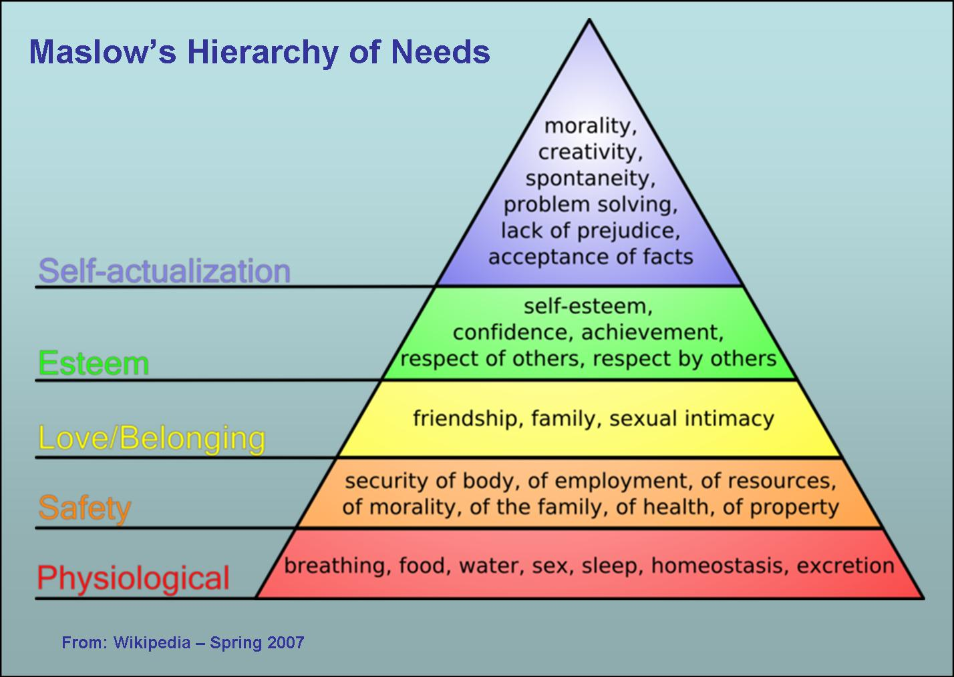
Understanding customer needs helps us understanding customer’s behaviors and anticipate their wants/needs
Behavior is motivated by the need to achieve certain needs

Slide 41

The Need to Be Understood
Need to be understood on an emotional level
  “tune-in” to your guests
  Establish rapport – connecting w/ customers on a feeling level
  See service encounter through their eyes, put yourself in their shoes - empathy

Slide 42

The Need to Feel Welcome
Need to feel like they belong
You are happy to see them and their business is important to you
May be intimidated, unsure of how to act
Need reassurance through your tone, actions, words

Slide 43
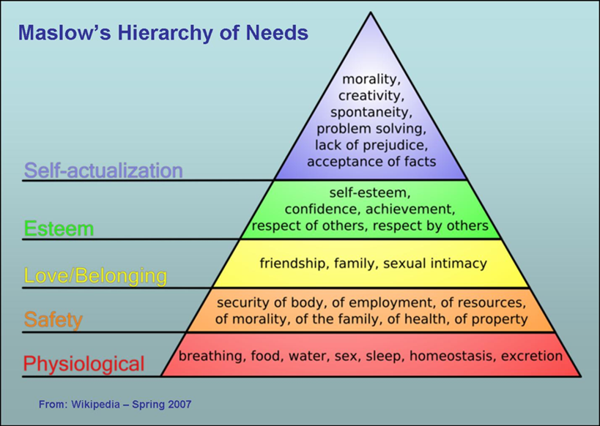
The Need for Comfort
Physiological – comfortable seats, clean room, restroom, ambience, etc.
Psychological – needs for assurance that they will be taken care of properly
Generating an atmosphere of relaxation and enjoyment

Slide 44
The Need to Feel Important
Fundamental human ego need to feel special, important, that we matter
Natural extension of all hospitality provider’s job
Price tag increase proportionate to need to feel important more evident in guests

Slide 45
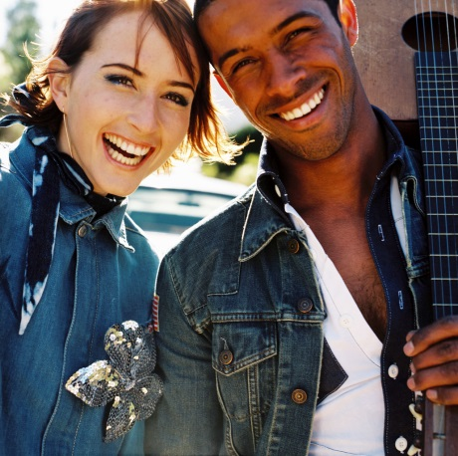
How do you know someone is happy?
How do you know someone is sad?

Slide 46

It’s All About the Attitude
A way of thinking or feeling towards someone or something that is reflected in one’s behavior
Customers use behavior and what you say in evaluating quality of service

Slide 47
Attitude
Body Language – the silent way our actions and posture show our thoughts and feelings
  Non-verbal
  Conveys 50-70% of total message

Slide 48

Attitude: Body Language
Facial Expression
  Worth a thousand words
  Communicate moods, attitudes and emotional states
  Smile – creates rapport and conveys warmth, respect, invites friendliness
  Eye contact – communicates sincerity, interest and trustworthiness, willingness to serve*

Slide 49
Attitude: Body Language
Hand and Body Movement
  Arms crossed – unwillingness to communicate, defensiveness
  Flailing arms – awkwardness, discomfort, nervousness
  Pointed fingers, jabs, clenched fists
  Posture – slouched posture give impression you lack confidence, self-discipline or are tired, erect, natural body movements – confidence and enthusiasm

Slide 50
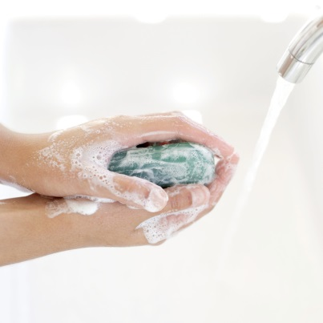
Attitude: Body Language
Proper Grooming
  Attitude of concern for customer
  Clean face, hands, fingernails, and clothes
  Avoid putting pencils/pens in hair, behind ear and in any way touching face, nose or hair – communicates uncaring attitude and lack of concern for basic health and cleanliness

Slide 51
Attitude: Tone
How you say things
Attitudes exhibited via the intonation of words spoken and the emphasis on certain selected words
  Good Evening (greeting/farewell, dismissal)
  May I bring you anything?
Appropriate tone varies with setting, circumstances and nature of service rendered
Basically – pleasant, enthusiasm, friendly, warmth

Slide 52
Speaking of Verbal Communication
Use proper grammar, no slang
Never use profanity
  Shows lack of manners
  Lack of respect for the business that employs them
  Shows an “I don’t care” attitude
  Don’t discuss another employee in front of guests

Slide 53
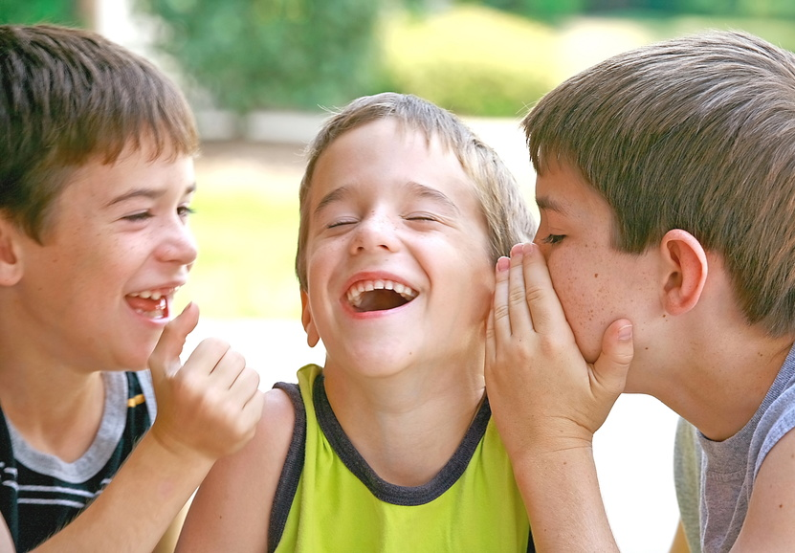
Attitude
Attitudes are contagious
Good or bad
Only takes ONE person to “infect” the group

Slide 54
Tact
Sensitivity when dealing with others
  “A food server pouring coffee for a group of four women noticed that one of the kept her hands under the table. He commented, ‘What’s the matter? Don’t you have any hands?’ She lifter her arms, exposing two artificial hands.”

Slide 55
Tact
Communication should contribute to customer enjoyment, relaxation and feelings of hospitality
  Correct grammar/use of language
  Appropriate to situation
  Tactful and inoffensive
    No careless, callous or otherwise stupid comment

Slide 56
The Challenge of Gracious Problem Solving
Ultimate test of quality service
Customer expectations:
  Handled quickly, smoothly, calmly, tactfully
  Problem acknowledged and dealt with
  Remember the four customer needs!
    Need to be understood
    Need to feel welcome
    Need for comfort
    Need to feel important

Slide 57
Gracious Problem Solving
Listen and repeat
Acknowledge
Apologize
Agree
Thank

Slide 58
Gracious Problem Solving: 5 steps
Listen and Repeat
  Listen carefully to what the complaint really is
  Understand fully and repeat what you heard back to customer
    Lets them know the complaint has been accurately communicated

Slide 59
Gracious Problem Solving: 5 steps
Acknowledge
  Acknowledge feelings: anger, frustration or disappointment
  “I understand how you feel” or “ This would make me upset too.”
  Expressing openness/support to his/her plight, non-defensive approach to solving the problem

Slide 60
Gracious Problem Solving: 5 steps
Apologize
  Say sorry
  Even if you are not the one to put them in this position, apologize for the guest being put in this situation

Slide 61
Gracious Problem Solving: 5 steps
Agree
  Get guest involved in deciding how the problem can best be solved
  Ask how he/she would like problem solved OR make suggestions
  Agree on solution together

Slide 62
Gracious Problem Solving: 5 steps
Thank
  Why? Complaints serve as invaluable feedback to you the service provider
  Without the complaint, you will never know a problem exists and cannot do anything to prevent or minimize it

Slide 63
FYI: Phrases to avoid
Avoid
Positive
I don’t know
We can’t do that
You’ll have to…
Hand on a second, I’ll be right back
No
I will find out, let me check on this
What I can do is…
May I help you to…
May I call you back in a few minutes
Yes

Slide 64
The Difficult Customer
Upon occasion, you will come across a customer who may be difficult for their own reasons, not because of you
  Demanding guest
  Nasty or obnoxious
  Very particular/picky
  Constant critic
  Nonstop talker
  Condescending
  Indecisive
  Intoxicated
  Argumentative
  Just doesn’t understand
  Rude or impolite

Slide 65
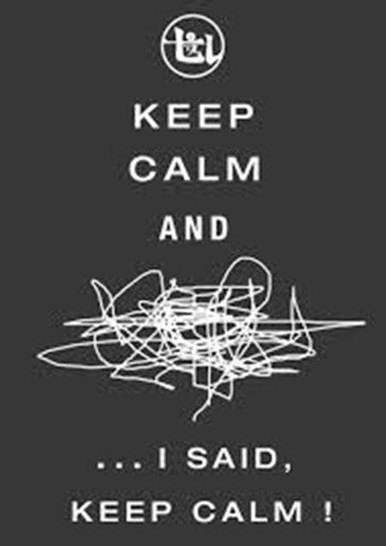
Difficult Customer
What to do?
  Don’t take it personally
  Remain Calm and Listen carefully
  Focus on the problem, not the person
  Reward yourself for turning a difficult customer into a happy one
  When all else fails, ask for help

Slide 66
Consistency
“Quality customer service is the ability to consistently meet external and internal customer needs, wants and expectations involving procedural and personal encounters.”
Consistent Service – unchanging or being constant over time

Slide 67
Why? QCS?
Key to establishing and maintaining a successful business
Depends on people because people talk = word-of-mouth publicity (think Yelp!), make recommendations
Can be good or bad
  Bad – 90% or more will not return = 100, 90 will not return, each will tell 9 people = 810 people who will never try your business
  Good - $150, tell two friends, tell two more = $600,000 over 10 years

Slide 68
FINALLY DONE! Woo-hoo!
Complete a 3-2-1 summary please
  Three things you LEARNED
  Two things you found INTERESTING
  One QUESTION you still have

